Slide 1

Technology Survey Analysis (Capstone project by IBM )
By Jagruti Chaudhary
2/11/2025

Slide 2



OUTLINE
Executive Summary
Introduction
Methodology
Results
Visualization – Charts
Dashboard
Discussion
Findings & Implications
Conclusion
Appendix

Slide 3

EXECUTIVE SUMMARY
A modified subset of stack overflow data consisting of two data set s bases on the demographics and technologies used were analyzed to identify the present and future technology trends among with various age groups
IBM Cognos Dashboard Embedded (CDE)platform was used to analyzed and visualize the results
From the current technologies dashboard
-Java script was the most popular language while MY SQL was the most popular database
-Linux and windows were the preferred platforms to work with and jQuery being the preferred
web frame
From the future technology trend
- Java Script was also the most desired language to learn as well as PostgreSQL the most sought-after data base to learn
-Linux and react.js were the preferred platform and web frame to be worked with in the upcoming year, respectively
From the dashboard Demographics dashboard
- 93.5% of the respondents were male with the majority residing in the USA and India between the ages of 21 to 43
-A large majority of the individuals who completed this survey had a master or bachelor's degree

Slide 4

INTRODUCTION
This presentation report uses data analytics to highlight current and projected trends in the need for skills related to programming languages ,databases, platforms and web frames
The following inquiries were investigated using the data
- which programming languages are most in demand today?
- what are the most in-demand database skills?
- what popular IDEs or web frames are there ?
The target audience for this research are IT professionals, HR managers, and anybody else with an interest in the It sector who wants to learn about the top on demand IT skills in their respective sector that will also still be relevant in the future

Slide 5

METHODOLOGY
Data in several formats, such as the number of jobs currently available for different technologies and for different places ,where gathered using the GitHub places, were gathered using the GitHub jobs API on python
To obtain the name s of the programming languages and their yearly wages ,the IBM website was scraped .the dataset from a 2019 stack overflowed developer survey was downloaded and saved
Python was used to clean and analyze the data. To assess the distribution of data, The presence of outliers, and the correlation between various columns in the dataset ,an exploratory data analysis was carried out
Chart, graphs, and dashboards were created using python and Cognos analytics to visualize the data. All the python analyses were carried out on Hand on Lab .

Slide 6
RESULTS
The data was collected from a survey on a Stack Overflow blog under OBDI: Open Database License.
It consisted of two data sets:
- survey data technologies normalized consisted of approximately 75,000 respondents querying them about the present and future technology interests.
- Survey data demographics was a more clustered dataset involving around 11,000 respondents answering questions about various demographics such as country, age , education level, ethnicity, gender etc. …
In the next few slides we be discussing the critical findings from the dataset from present and future technologies as well as the demographics of the respondents.

Slide 7
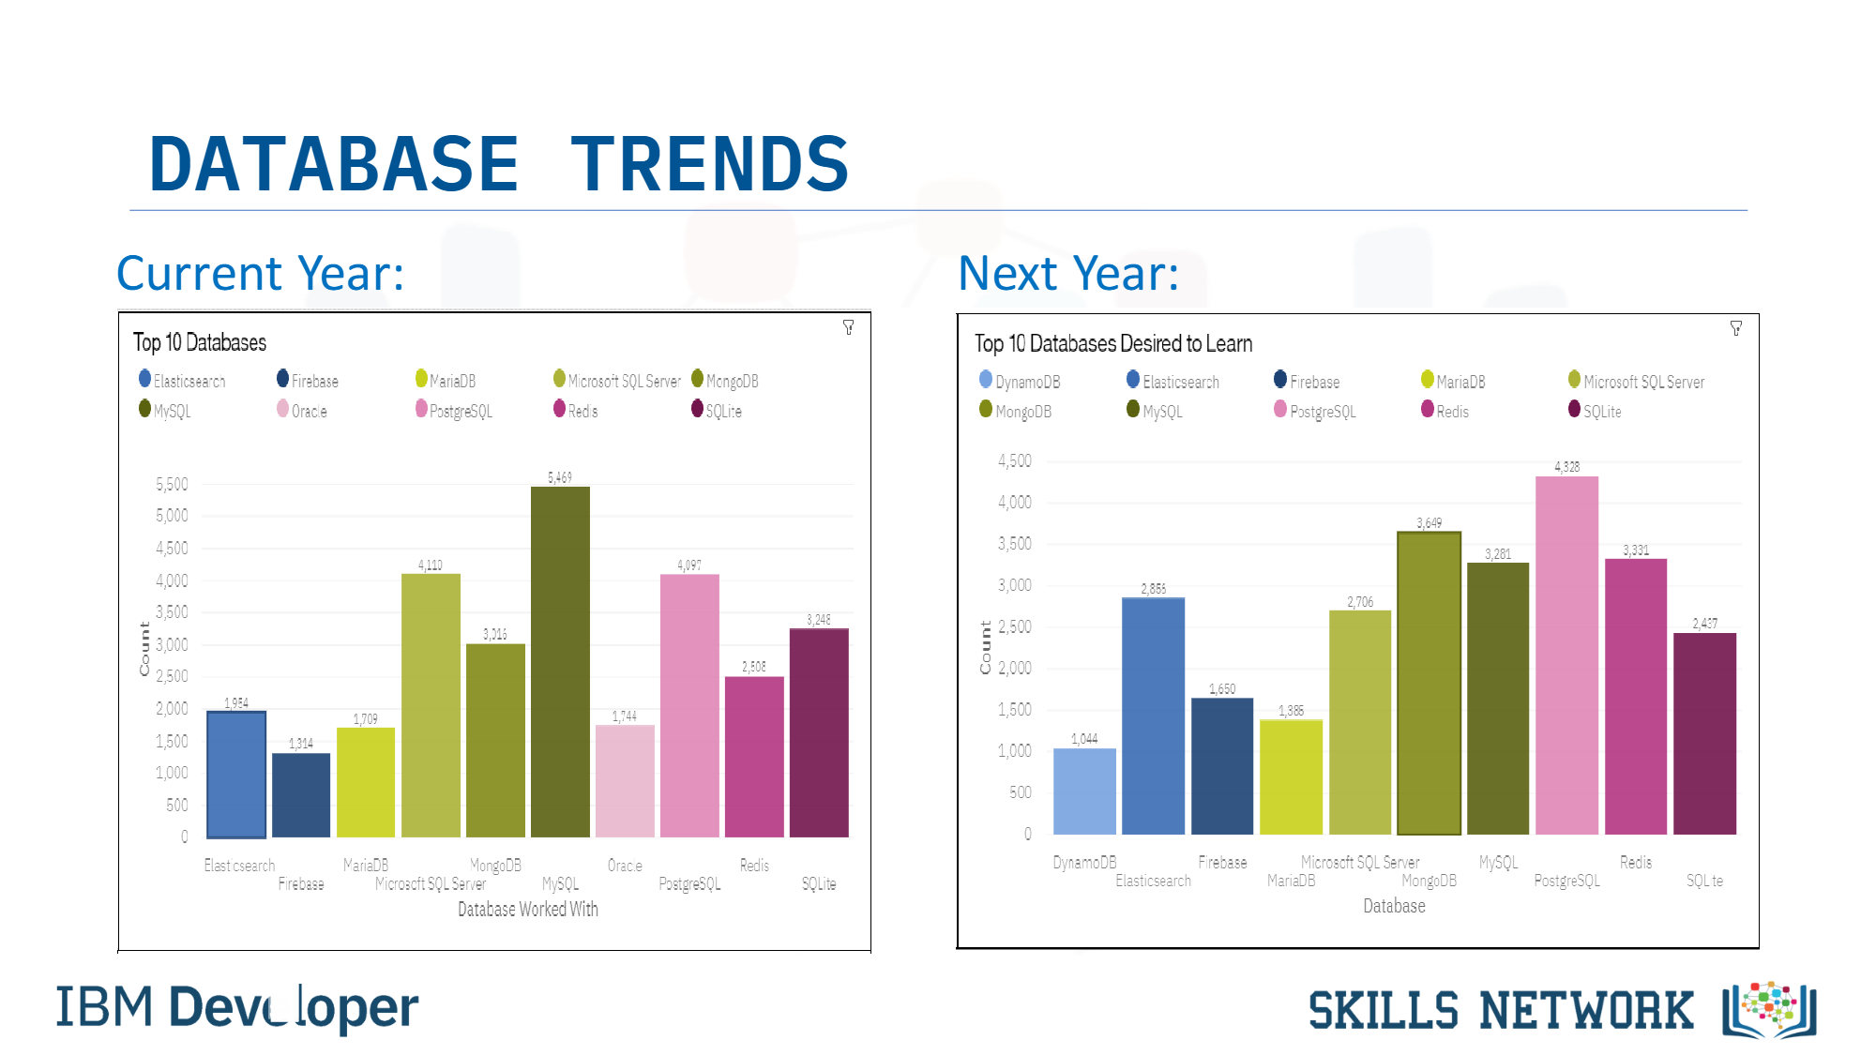
PROGRAMMING LANGUAGE TRENDS
Current Year
Next Year
<Bar chart of top 10 programming languages for the current year goes here.>
< Bar chart of top 10 programming languages for the next year goes here.>

Slide 8
PROGRAMMING LANGUAGE TRENDS - FINDINGS & IMPLICATIONS
Findings
My SQL was the most dominant database to work with developers , however over the next few years we may see a decline in its preference
PostgreSQL was the next database that is preferred among developers and was also the most desired database to learn in the coming years
MongoDB was ranked 5th in database s currently in use, however it’s popularity is increasing and is the 2nd most desired database to learn in the coming years.
Implications
We may be see more Organization implementing PostgreSQL and MongoDB as the popularity increases in the coming years.
MySQL may reach a saturation point and would not be sufficient enough to give you an edge over others in terms of skills
Companies still preferences open sources database

Slide 9
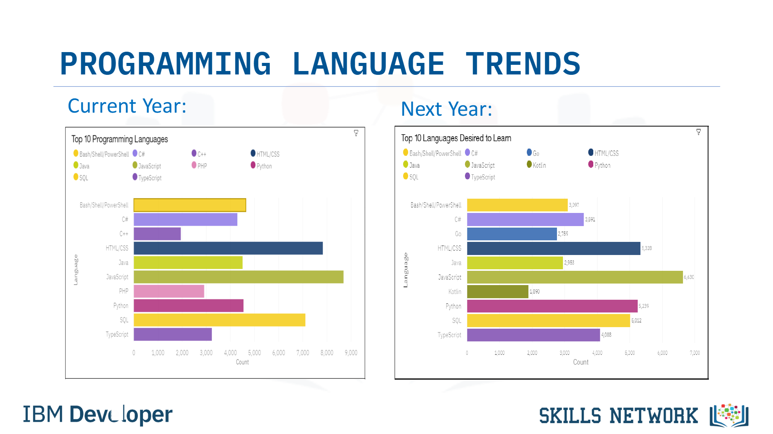
DATABASE TRENDS
Current Year
Next Year
< Bar chart of top 10 databases for the current year goes here >
< Bar chart of top 10 databases for the next year goes here.>

Slide 10
DATABASE TRENDS - FINDINGS & IMPLICATIONS
Findings
MySQL , Microsoft SQL ,server ,Postage SQL, SQLite and MongoDB are the top 5 most used database at the moment
However ,Postgres SQL ,MongoDB ,Redis, MySQL and Elastic sense are projected to become more popular in the future
Redis and Elastic sense are relative new tools and are set to gain more traction in the IT space.
Implications
SQL is still a top tool to watch out for in data specialists
Companies still prefer open source databases
Oracle SQL was not among the top 5 it is losing relevance as time passes

Slide 11

DASHBOARD
<The GitHub link of the Cognos/Looker Studio dashboard goes here.>
https://github.com/DaJagu/IBM-D.A-Capstone-Project/blob/main/Lab%2012%20Finding%20Outliers.ipynb

Slide 12
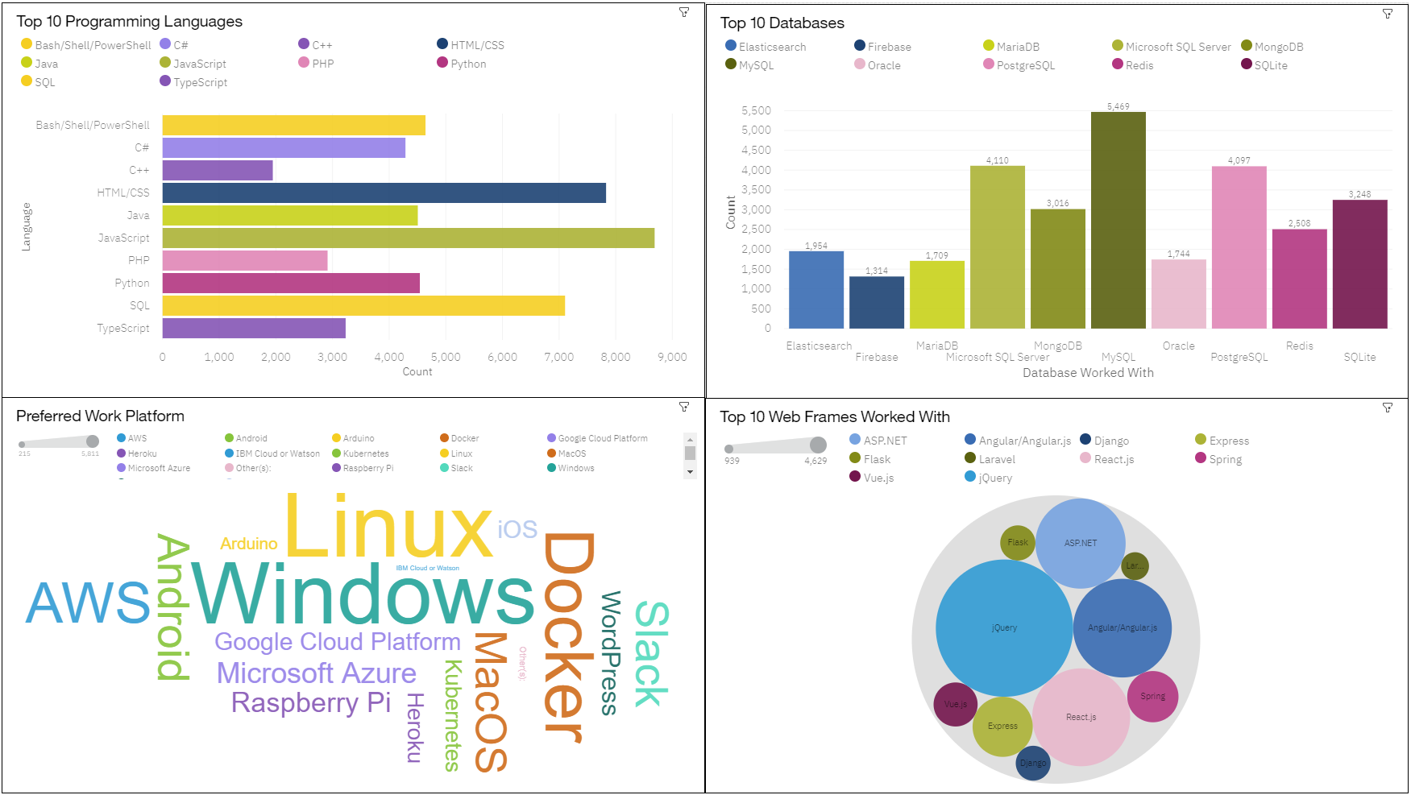
DASHBOARD TAB 1
Screenshot of dashboard tab 1 goes here

Slide 13
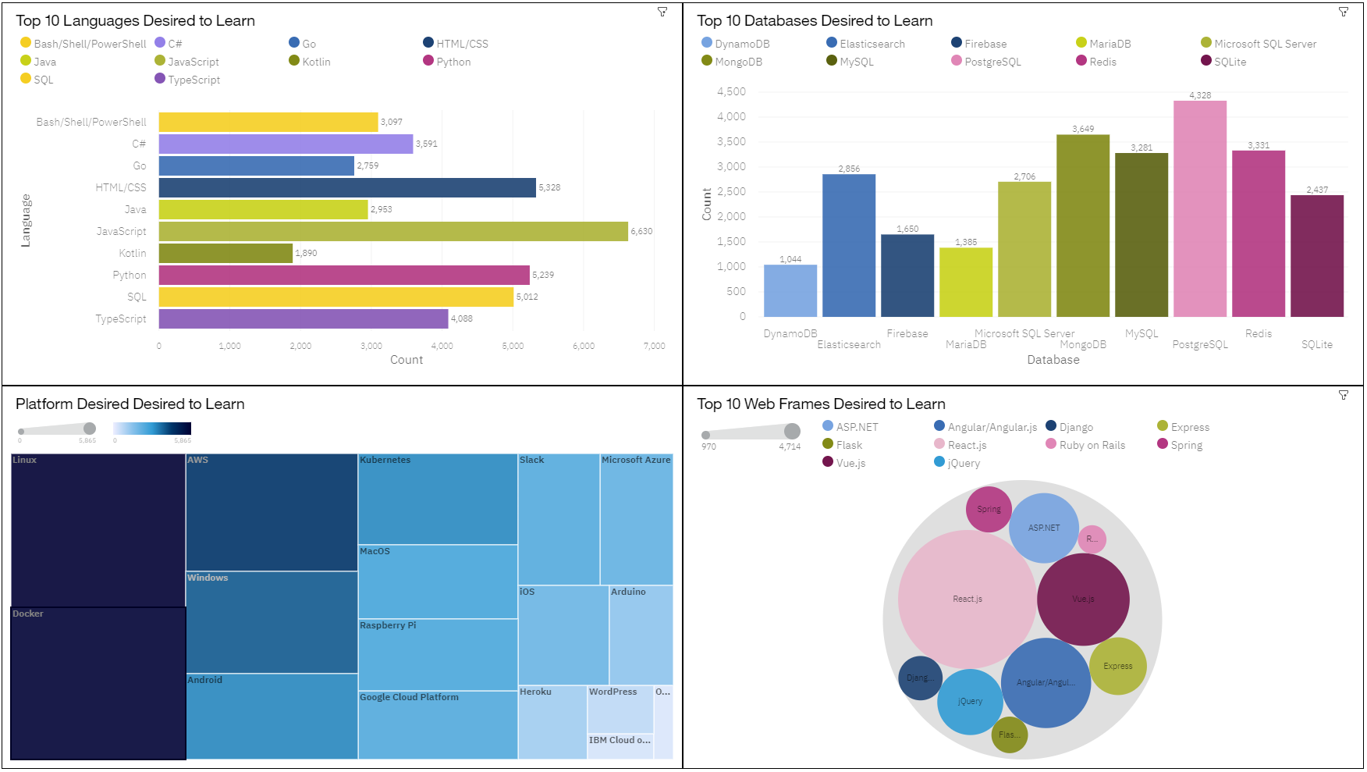
DASHBOARD TAB 2
Screenshot of dashboard tab 2 goes here

Slide 14
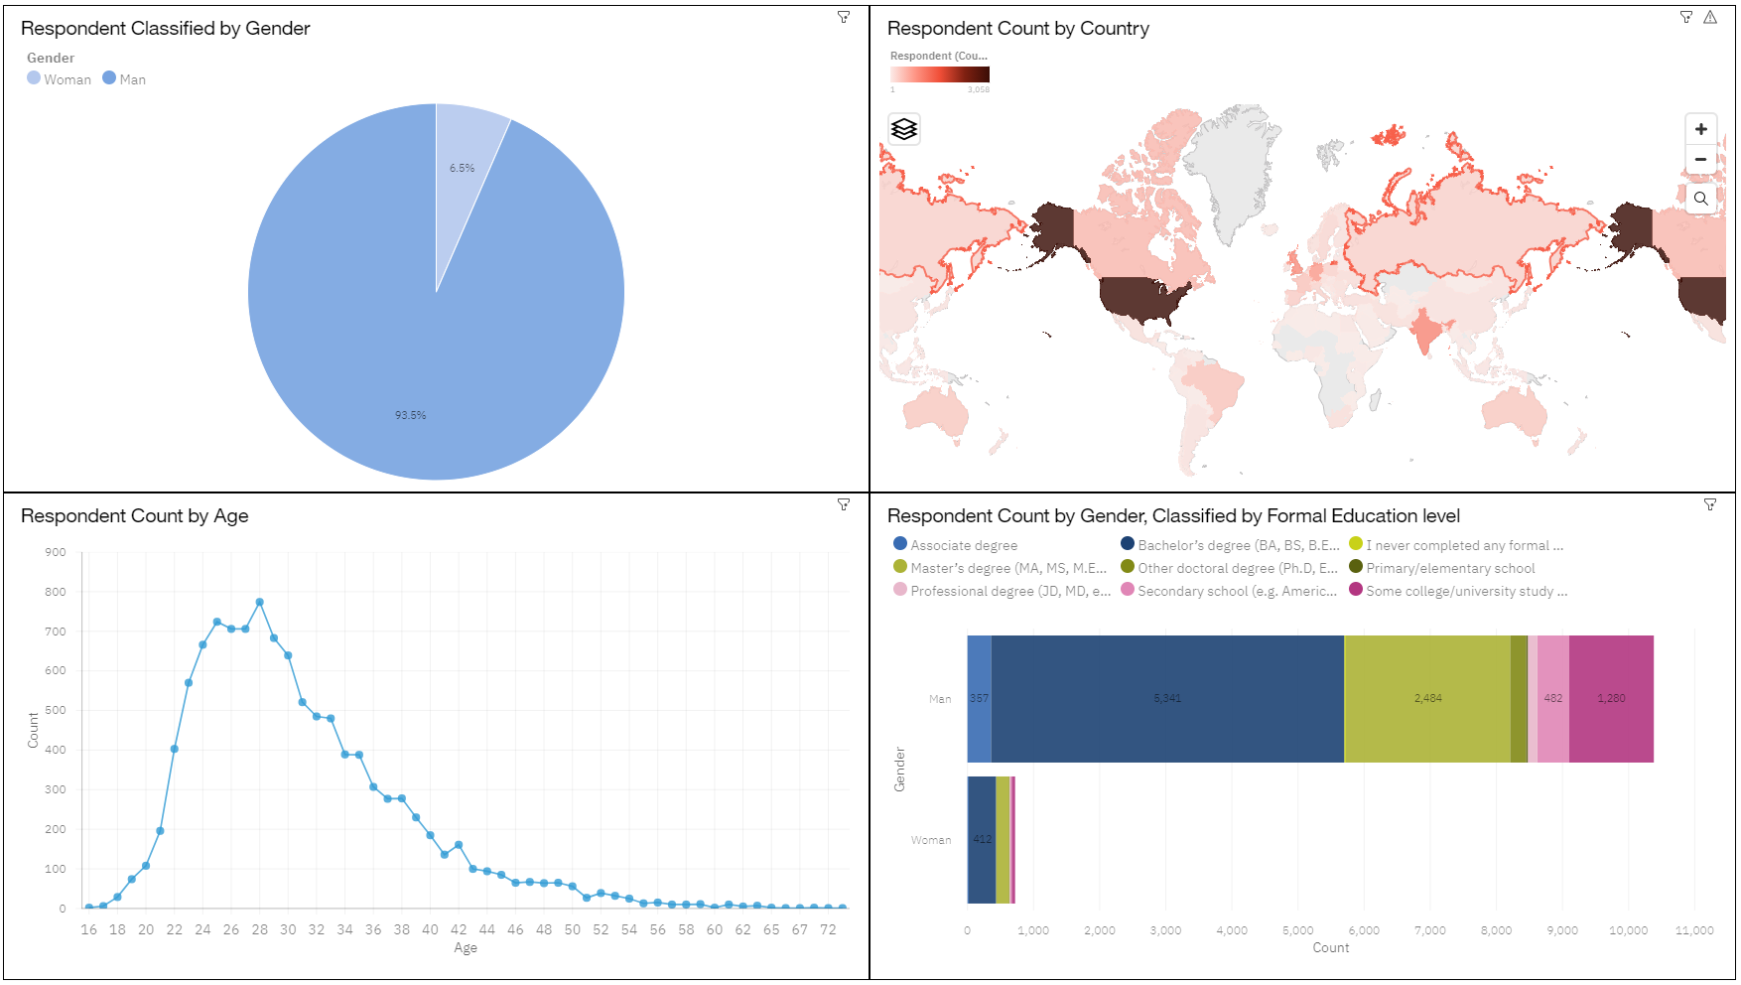
DASHBOARD TAB 3
Screenshot of dashboard tab 3 goes here

Slide 15
DISCUSSION
Languages will SQL and Python loose dominance in the upcoming years as other language s emerge in popularity?
Databases will MongoDB and PostgreSQL replace MYSQL as the preferred database to work with in the future?
Why is the popularity of MySQL declining so drastically?
Up skilling in the Technology sector
The increasing demand for mobile development as Kotlin is getting popular.
More tech education ,access and development in less developed regions in south east Asis ,south America ,Africa and some parts of Europe.
How relevant will Oracle SQL still be in the future?
Is completing a master or doctorate degree really a requirement?

Slide 16
OVERALL FINDINGS & IMPLICATIONS
Findings
The technology survey results are dominated by the male population with a majority of them being from the USA followed by India between the age groups of 21 to 43
Specializing in data technology was highly preferred among students with a bachelor’s or master degree
Implications
Seeing the popularity amongst the youth may lead to more bootstrap camps being set up to enhance their skillset
The popularity trend may pick up in other countries too as more multinational corporations diversify into this sector

Slide 17

CONCLUSION
We wanted to analyze the dataset for the preferred current and future trends n technology while also considering the demographics of the respondents
From the visualizations it is clear that technology trends are preferred between the age group between 21 and 43
Among programming languages ,HTML and Lava Script are the most popular languages to work with and will remain so in the coming years according to the future technology trends
Among the database to work with ,we may see the popularity of MYSQL decreasing and being replaced with PostgreSQL and MongoDB
We may see an increase in the use of these technologies in other countries Multinational corporations diversify into this field to keep up with competition

Slide 18
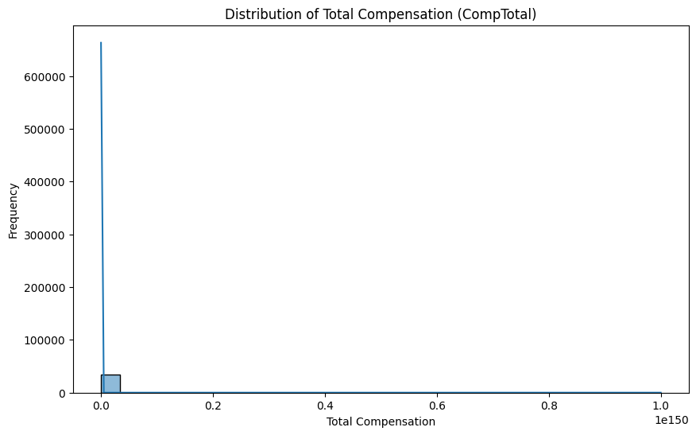

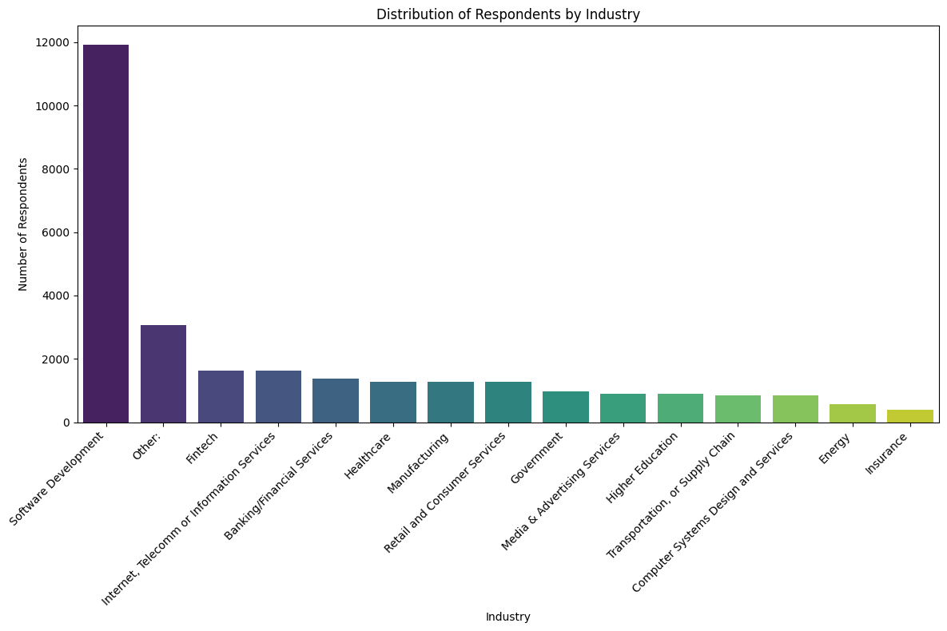
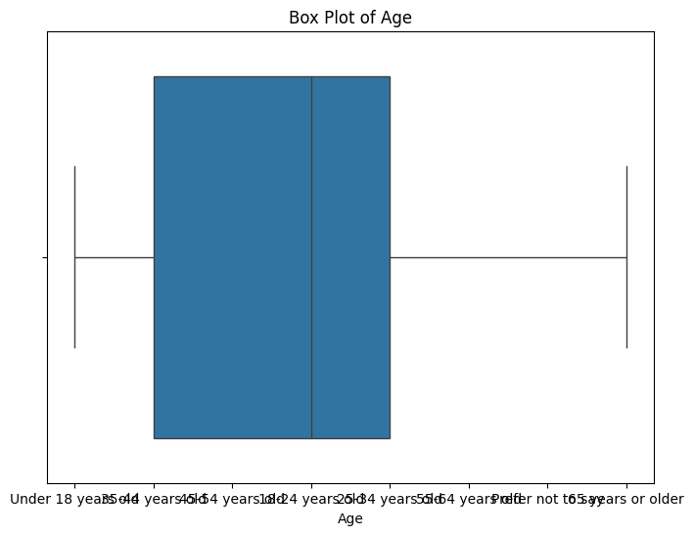
APPENDIX
Include any relevant additional charts, or tables that you may have created during the analysis phase.

Slide 19
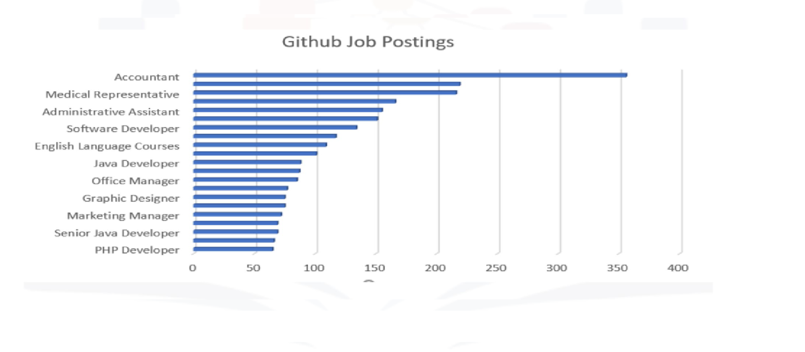
JOB POSTINGS
Job posting data using Job API

Slide 20
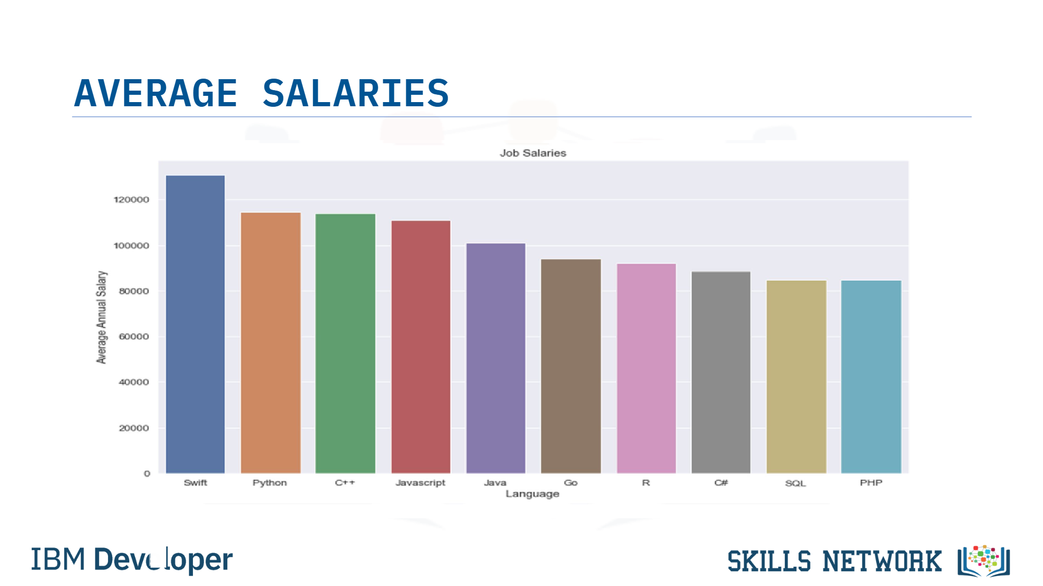
POPULAR LANGUAGES
Present that data using a bar chart here. Order the bar chart in the descending order of salary.

